Slide 1

National Symbols of Bangladesh

Slide 2

National Flag
Information
Here is some information about the national flag of Bangladesh:
Colors: The flag is bottle green with a red disc in the middle.
Shape: The flag is rectangular with a length-to-width ratio of 5:3.
Symbolism: The green background represents the youthfulness and greenery of the country, while the red disc symbolizes the rising sun of independence and the blood of those who died for the country's independence.
History: The flag was officially adopted on January 17, 1972. It was based on a similar flag used during the Bangladesh Liberation War of 1971, but the map of the country inside the red disc was removed in 1972.

Slide 3

National Fishs
Information
The ilish also known as the ilishi, hilsa, hilsa herring or hilsa shad, is a species of fish related to the herring, in the family Clupeidae. It is a very popular and sought-after food in the Bengal region, and is the national fish of Bangladesh and state fish of the Indian state of West Bengal

Slide 4
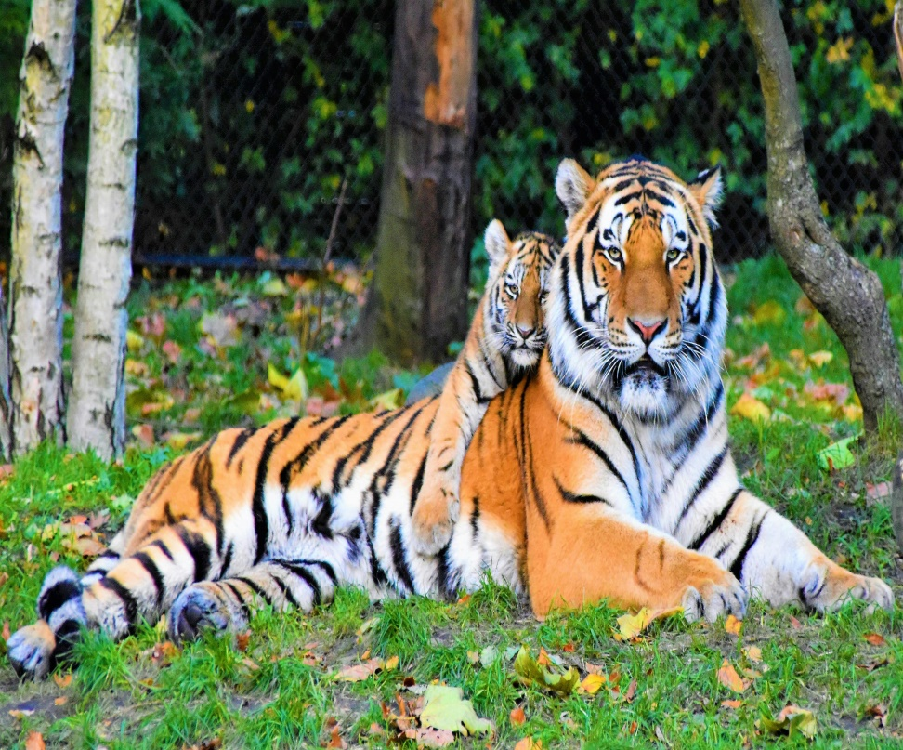
National animal
Information
The tiger is a large cat and a member of the genus Panthera native to Asia. It has a powerful, muscular body with a large head and paws, a long tail and orange fur with black, mostly vertical stripes.

Slide 5
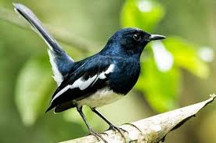
National bird
Information
he Oriental magpie-robin is a small passerine bird that was formerly classed as a member of the thrush family Turdidae, but now considered an Old World flycatcher. They are distinctive black and white birds with a long tail that is held upright as they forage on the ground or perch conspicuously.

Slide 6
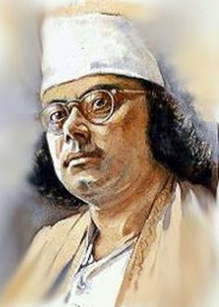
National poet
information
Kazi Nazrul Islam (25 May 1899–29 August 1976) was a Bengali poet, musician and revolutionary. His nickname was "Rebel Poet". He was the first to make poems talking about intense spiritual rebellion against fascism and oppression. Nazrul is the national poetof Bangladesh. He is commemorated in India.

Slide 7
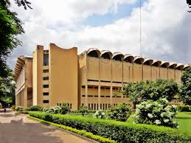
National museum
Information
Bangladesh National Museum was originally established on 20 March 1913, albeit under another name (Dacca Museum), and formally inaugurated on 7 August 1913 by The Lord Carmichael the governor of Bengal. In July 1915 it was handed over to the Naibazim of Dhaka.Bangladesh National Museum was formed through the incorporation of Dhaka museum and it was made the national museum of Bangladesh on 17 November 1983. It is located at Shahbag, Dhaka. It has several publications from 1978, first was "Islamic Art in Bangladesh, Catalogue".

Slide 8
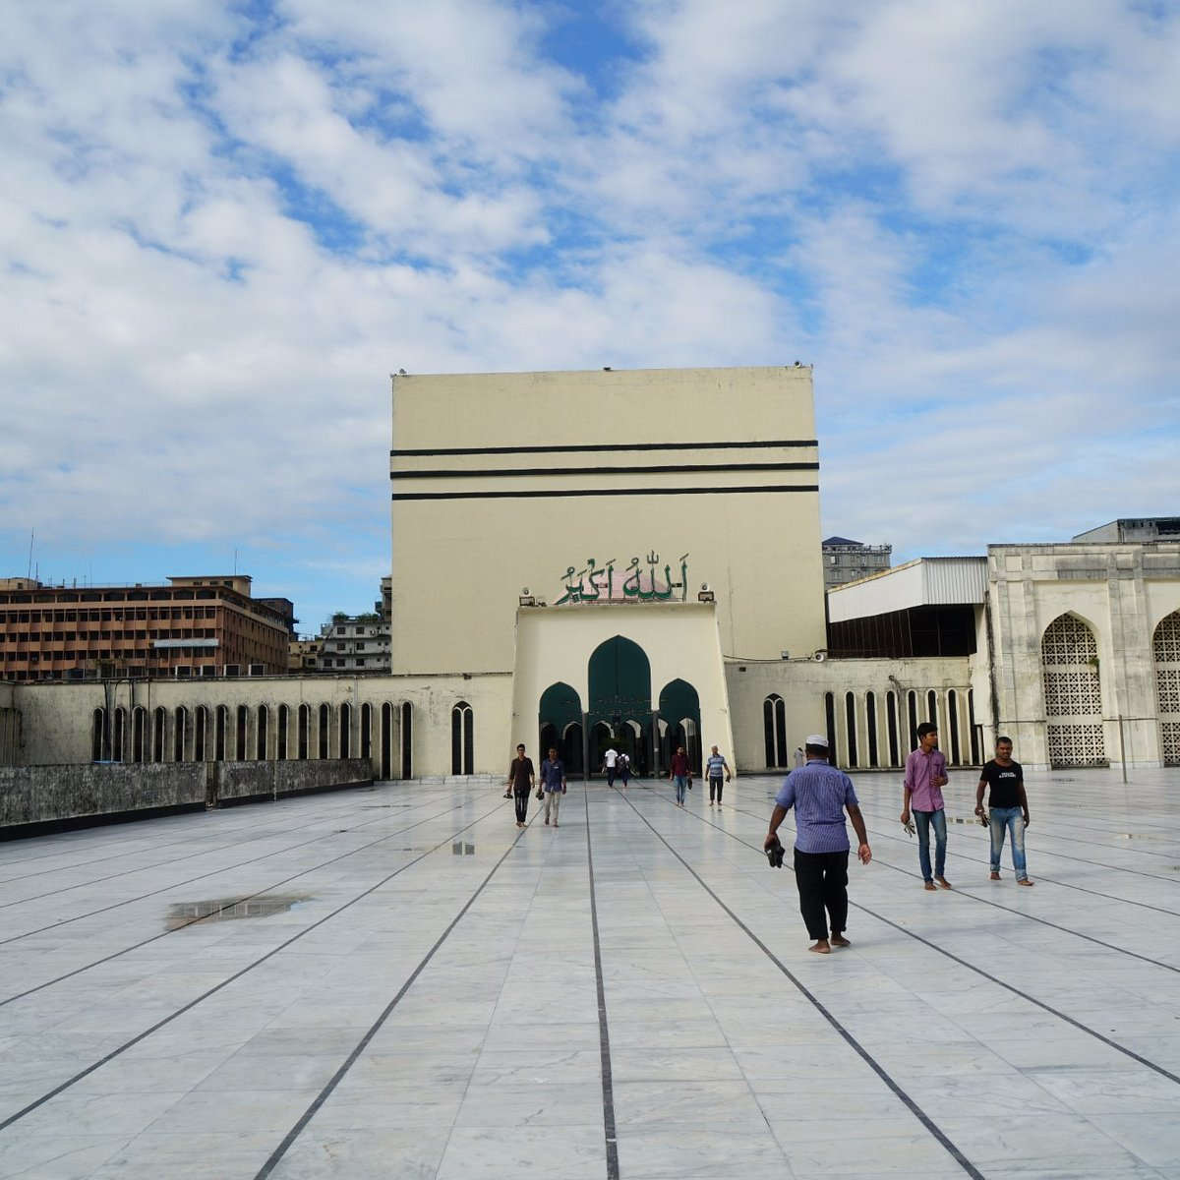
National mosque
Information
The mosque complex was designed by architect, Abdulhusein M. Thariani On 27 April 1959, Abdul Latif Ibrahim Bawani, owner of then Bawani Jute Mills, held a meeting at his house with GA Madani, Haji Abdul Latif Bawani, MH Adamji, S Sattar, Muhammad Sadiq, AZN Rezai Karim and Major General Umrao Khan.In that meeting he proposed to Major General Khan, then military administrator of East Pakistan, that a grand mosque be built in Dhaka. Umra Khan agreed to help build such a mosque. The same year, a Baitul Mukarram mosque committee was established and 8.30 acres of land between new Dhaka and Old Dhaka was chosen for the site. At that time, there was a large pond in the present mosque's location.

